Slide 1
How to Use Zoom

Slide 2
How to Download Zoom
Go to https://doane.zoom.us
Click on “Download”
Click on “Download” under Zoom Client for Meetings
Any other things that are needed you will be prompted to as you need them

Slide 3
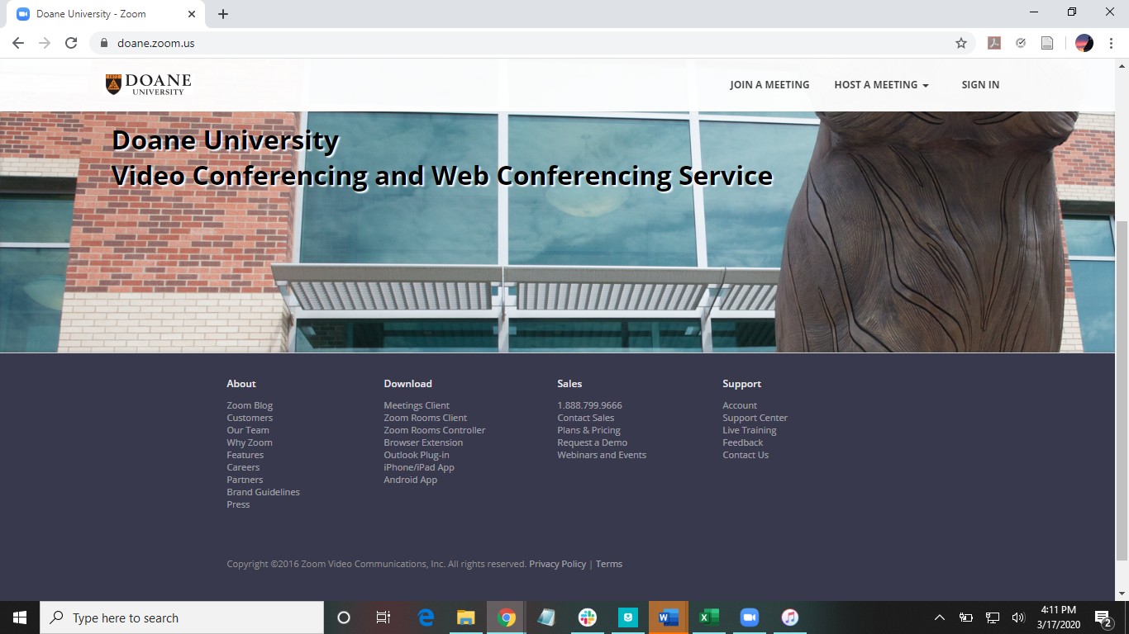
Click Here

Slide 4
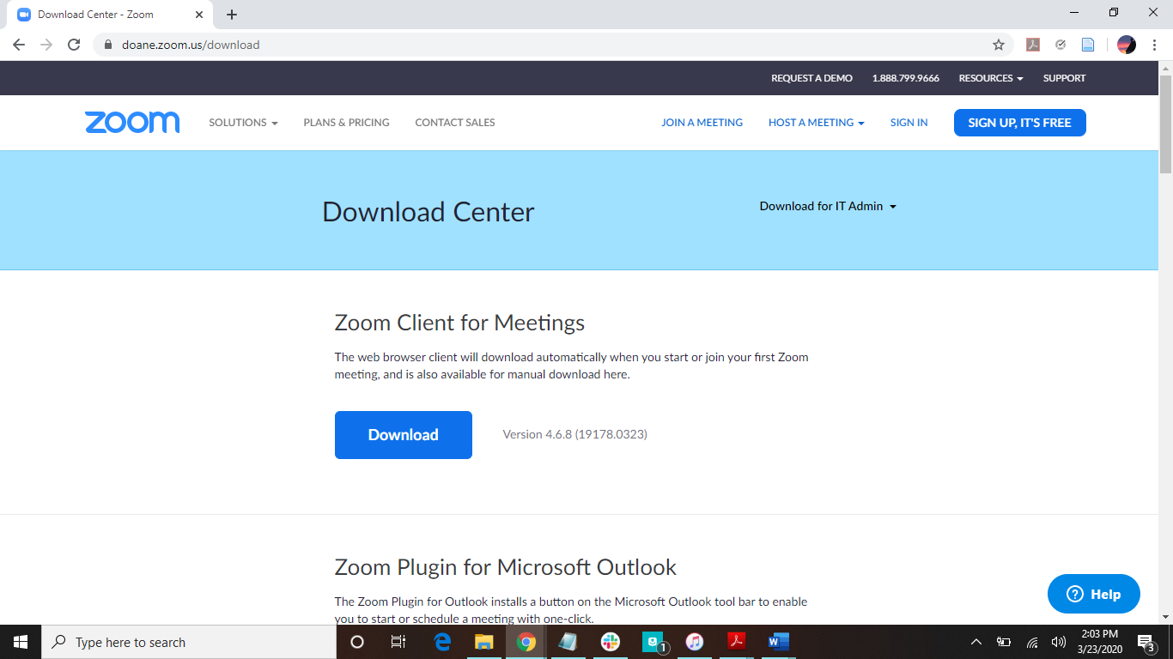
Download this one!

Slide 5
How to Join a Meeting
The host of the meeting will email you a link to join.
Click on the link to join the meeting.
If it is scheduled meeting, you may not be able to join until the host has joined.
There also may be a password to join the meeting, which will also be in the email from the host.

Slide 6
How to Create a Zoom Meeting
First, for spontaneous meetings:
1. Open your Zoom desktop icon
2. Click New Meeting
3. Once in the meeting, click on “Invite” to email the meeting link to participants
Second, for scheduled meetings:
1. Open your Zoom desktop icon
2. Click Schedule
3. Edit the settings to your liking
4. Click on Schedule
5. Once it is on your calendar, you can invite participants

Slide 7
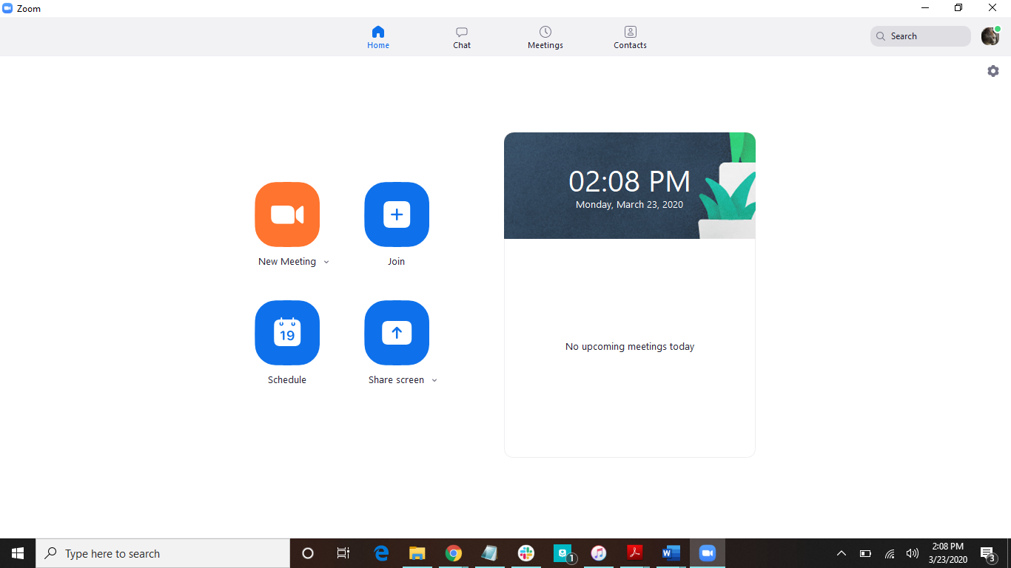
1
Click Here

Slide 8
2
Click Here

Slide 9
Cool Features to Understand
Screen Sharing
Breakout Rooms
Closed Captioning
Recording a Meeting

Slide 10
Screen Sharing
When in a meeting, you can click on the “Share Screen” button on the bottom. With this, you can choose to share your desktop or anything you may have pulled up, such as PowerPoints, videos, etc.
When sharing your screen, you can set that everyone hears your computer’s audio, which is especially helpful when showing a video.
Multiple screens can be shared as well. This requires a slight settings change. Click on the up arrow next to “Share Screen”, and click on “Multiple participants can share simultaneously”. With this, all participants have the option of sharing their screen.

Slide 11
Breakout Rooms
To use this, you need to update your settings.
1. Open your Zoom desktop icon
2. Click on the Settings icon
3. Click on Profile
4. Click on View Advanced Features
5. Enable Breakout room
Once this is enabled, you as the host can break participants into groups for discussion or collaboration. You as the host can choose who is in each group, and then visit each group to check in. Participants can also ask for help from you by pressing on the ask for help button.

Slide 12
Closed Captioning
To use this, you also need to update your settings.
1. Open your Zoom desktop icon
2. Click on the Settings icon
3. Click on Profile
4. Click on View Advanced Features
5. Enable Closed captioning
Once this is enabled, you can type out closed captions or assign someone to type them out.

Slide 13
Recording a Meeting
This is really simple. Just click on the Record button on the bottom of the screen. Pause and end recording up at the top. The recording will be saved once you end the meeting.

Slide 14

Have more questions?
Email us at ccla@doane.edu or come visit us in Communications 188D from 9am to 5pm.
You can also visit our website at https://www.doane.edu/ccla

Slide 15
Reference
Zoom Video Tutorials. (n.d.). Retrieved from https://support.zoom.us/hc/en-us/articles/206618765-Zoom-Video-Tutorials?flash_digest=801539d771b2115b505423671954fdc58777636d

Slide 16
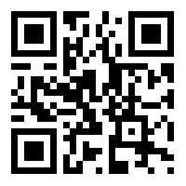
Please provide some feedback on the presentation by following the QR Code below.

